Slide 1

PROJECT WORK
REVIEW
Date : 28/12/2023
​

Slide 2
Missing Ship Detection on Water Bodies

Slide 3
Project student’s details :
Supervisor:
DR.D.Durga Bhavani
Assistant Professor
Domain:
Machine Learning
S . No | Student Name | Roll Number
1 | E.Mounika | 20951A0593
2 | A.M Vishwa Nethra | 20951A0576
3 | K.Jayanth Sai | 20951A0564

Slide 4
Introduction
The detection of ships is an essential task for a large variety of applications in both military and civilian fields. This study proposes a ship detection method from images taken at ocean and sea using Artificial Neural Network (ANN) and Convolutional Neural Network (CNN). Detection of Ships is very much important for the safe operation of ships and enables collision avoidance.
In War, It is very helpful for finding other countries' ships that are closer to our territories. Detection of ships is complicated, especially under unfavourable conditions, such as during night time or cloudy days. Here we are using satellite images of ships. We will try to detect a Ship with Maximum Accuracy using ANN, CNN, and other approaches. Ship Detection is a process of identifying whether a Ship is present in a given image or not..

Slide 5
Introduction
The aim of ship detection using Artificial Neural Networks (ANN) and Convolutional Neural Networks (CNN) is to develop advanced machine learning models that can accurately identify and classify ships within various types of imagery, such as satellite images or photographs. Ship detection using ANN and CNN has several specific goals and applications , including:
Maritime Security: The technology can be used for maritime security and surveillance purposes, enabling the automatic detection and monitoring of ships in specific regions.
Search and Rescue Operations: Ship detection can aid in search and rescue operations by automatically identifying and locating ships in distress or in need of assistance.
Monitoring Illegal Activities: ANN and CNN-based ship detection can help monitor and identify illegal activities such as piracy, illegal fishing, and smuggling in maritime areas.
Traffic Monitoring and Management: The technology can assist in tracking and managing maritime traffic, ensuring the smooth flow of vessels and preventing congestion in busy waterways.

Slide 6
Existing Solutions
With the rise of autonomous vehicles, autonomous ships have attracted more attention, especially for long-distance and short-distance cargo ships and special ships participating in high-risk military operations .
Some ships are equipped with automatic identification systems (AISs) and broadcast their own position and other information through radio signals, which can be received by surrounding ships to avoid collisions.
However, little marine crafts (canoes, kayaks, sailboats, small fishing boats, etc.) are often not equipped with AIS and the signals emitted by AIS are vulnerable to interference.
Therefore, for ship management in the marine environment and the unmanned and autonomous navigation of ships, the ability to accurately detect ships is needed.
.

Slide 7
Proposed solution
The exiting methods are Traditional ship detection methods which comprise the following steps: preprocessing, sea–sky line (SSL) detection, region of interest (ROI) extraction, and identification but these are helpful under normal circumstances
So to overcome all the problems we use this detection by using Artificial Neural Network and Convolutional Neural Network (CNN).
To get the more accurate result we use the Convolutional Neural Network (CNN).

Slide 8
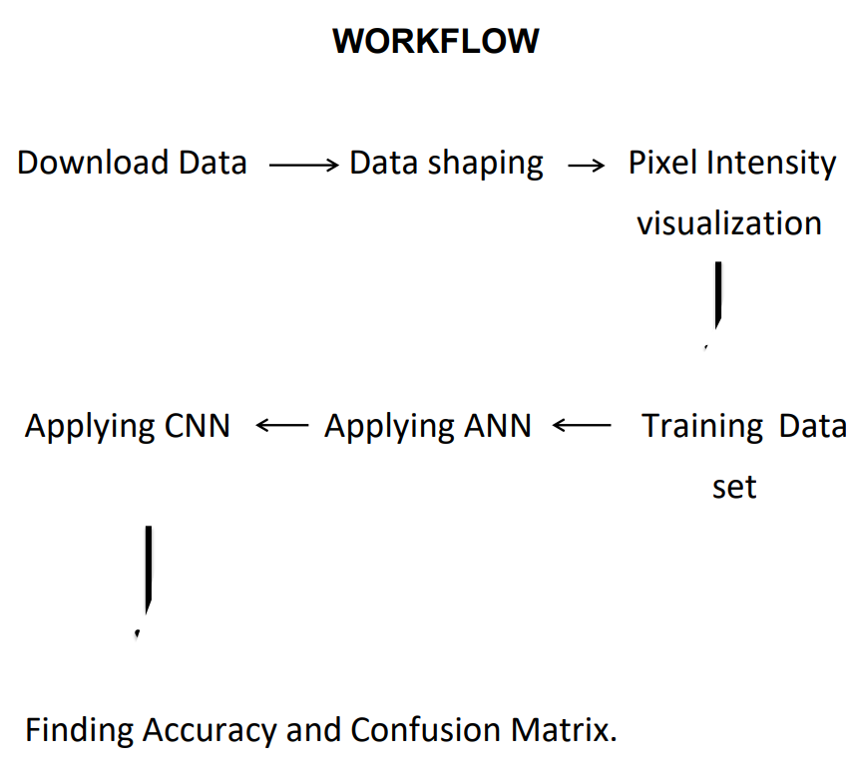
Methodologies

Slide 9
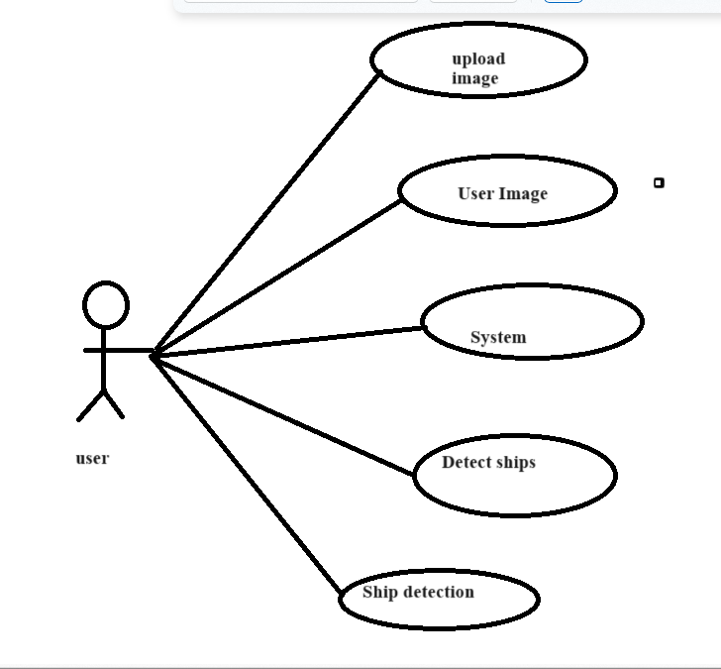
Use Case Diagram

Slide 10
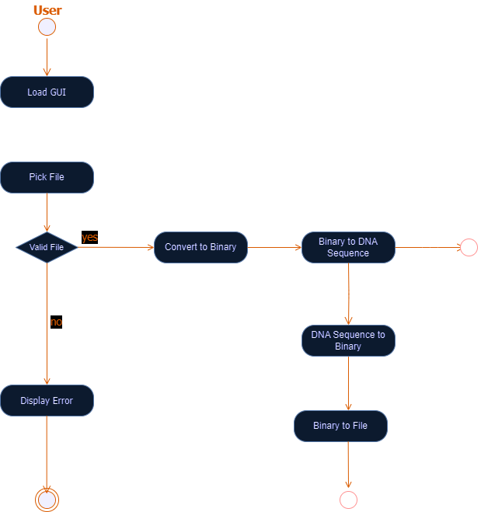
Activity Diagram

Slide 11
Artificial Neural Network
What is ANN?
• A neural network is computational learning system. That uses network of functions to understand data input into one of the form into desired output.
• It was inspired by human biology and the way neurons of brain work
LAYER OF ANN:
INPUT LAYER : - In human brain senses are input signals. In terms of artificial neural network independent variables are input layer. Like independent variable1, independent variable2, .. independent variables.
OUTPUT LAYER : - In which output value comes in binary format ( in yes/no ) from the hidden layer or continuous like a price.
Hidden layer or neuron : - A layer in between input layers and output layers, where artificial neurons take in a set of weighted inputs and produce an output through an activation functio

Slide 12
Convolutional Neural Network
What is CNN ?
• It is neural network with some mathematical operation between the layers
CNN is an efficient recognition algorithm which is widely used in pattern recognition and image processing. It has many features such as simple structure, less training parameters and adaptability.
• It’s main objective is to extract features from the image and learn all features from image that would help in object detection.
CNN model consists of :-
1. Input layer
2. Convolution layer
3. Pooling layer
4. Fully Connected Layer

Slide 13
Convolutional Neural Network
Input Layer : It contains the data of images in RGB format on which we are going to apply CNN
Convolutional Layer:In this layer we apply filter on input layer to extract the important features of images. • We apply filter on image multiple times to extract and detect features of input image
Pooling Layer • This layer is applied just after the convolution layer and it reduces the dimension of feature map which help in preventing the important features of input map from loss and reduces the computation time. • Using pooling, a lower resolution version of input is created that still contains the large or important elements of the input image
Fully Connected Layer: Fully Connected Layer connects the information extracted from the Convolution layer and Pooling layers to the output layer and eventually classifies the input into the desired label

Slide 14
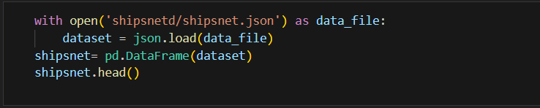
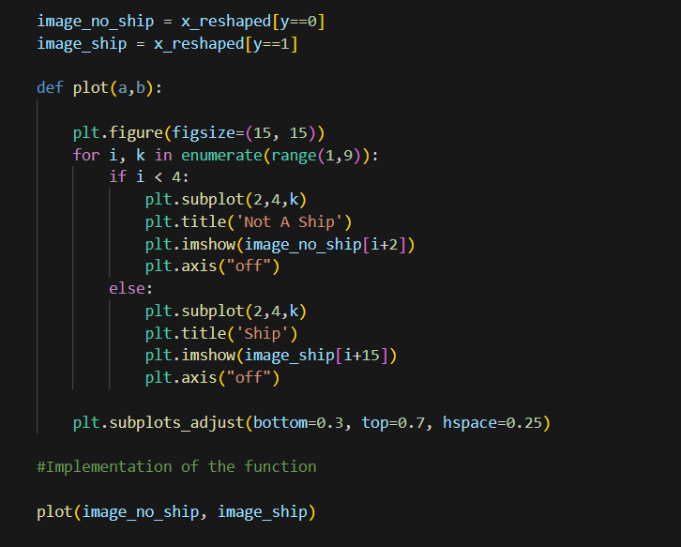
Code
Fig- 1:collecting data from data sets
Fig- 2:Classifying the data in to ships and non ships

Slide 15
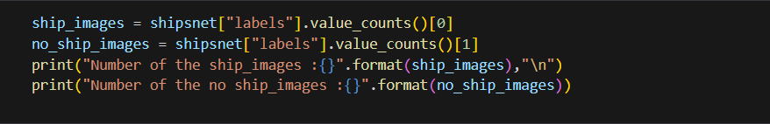
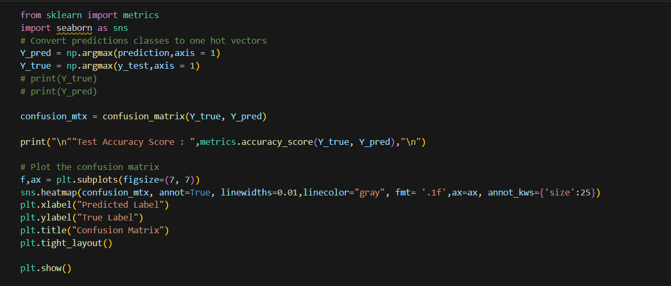
Code
Fig-3: Calculating number of ships and non ships
Fig-4:Finding the accuracy

Slide 16
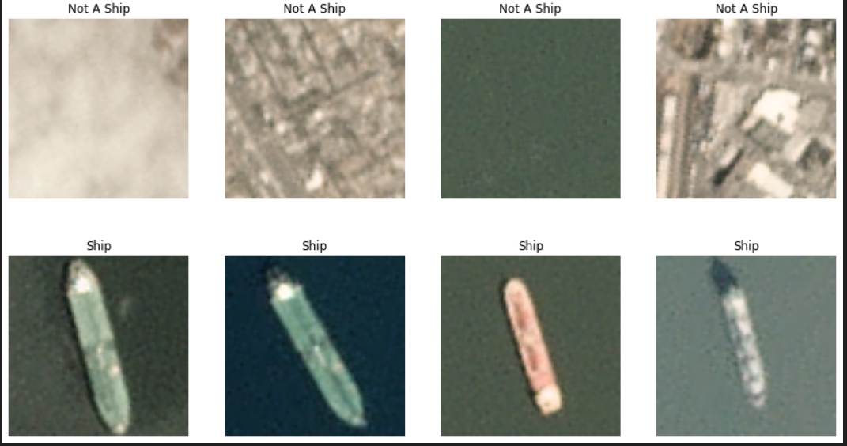
Result

Slide 17
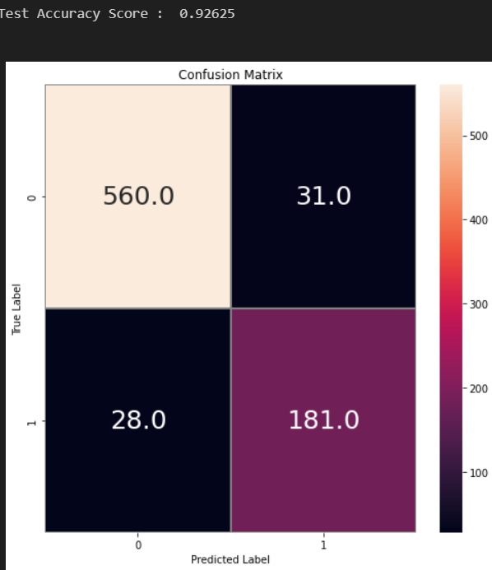
Result

Slide 18
References
Abderrahmane A, Adnane G, Yacine C, Khireddine G, (2019). Android malware detection based on system calls analysis and CNN classifcation. In: 2019 IEEE wireless communications and networking conference workshop (WCNCW) (pp 1–6). IEEE
Almahmoud M, Alzubi D, Yaseen Q (2021) ReDroidDet: android malware detection based on recurrent neural network. Procedia Comput Sci 184:841–846. https://doi.org/10.1016/j.procs.2021.03.105
Bai Y, Xing Z, Ma D, Li X, Feng Z (2021) Comparative analysis of feature representations and machine learning methods in android family classifcation. Comput Netw 184:107639
Meijin L, Zhiyang F, Junfeng W, Luyu C, Qi Z, Tao Y, Yinwei W, Jiaxuan G (2022) A systematic overview of android malware detection. Appl Artif Intel 36(1):2007327. https://doi.org/10.1080/08839514.2021.2007327

Slide 19
References
C. Yaman and V. Asari, "Long-Range Target Classification in a Cluttered Environment Using Multi-Sensor Image Sequences," 2007 3rd International Conference on Recent Advances in Space Technologies, Istanbul, 2007, pp. 304-308.
[4] G. Soni, A. Singh and N. Sharma, "Inshore ship and hybrid object detection and recognition using context-aware color and shape model," 2015 International Conference on Control, Instrumentation, Communication and Computational Technologies (ICCICCT), Kumaracoil, 2015, pp. 699-703.
[5] N. Rahmani and A. Behrad, "Automatic marine targets detection using features based on Local Gabor Binary Pattern Histogram Sequence," 2011 1st International eConference on Computer and Knowledge Engineering (ICCKE), Mashhad, 2011, pp. 195-201.
[6] F. Yang, Q. Xu, F. Gao and L. Hu, "Ship detection from optical satellite images based on visual search mechanism," 2015 IEEE International Geoscience and Remote Sensing Symposium (IGARSS), Milan, 2015, pp. 3679-3682.
[7] T. Li, Z. Liu, L. Ran and R. Xie, "An efficient scheme for ship detection in high-resolution TerraSAR-X images," 2016 CIE International Conference on Radar (RADAR), Guangzhou, 2016, pp. 1-4

Slide 20
References
. [8] W. Li et al., "Integrated Localization and Recognition for Inshore Ships in Large Scene Remote Sensing Images," in IEEE Geoscience and Remote Sensing Letters, vol. 14, no. 6, pp. 936-940, June 2017.
[9] B. Be binar, A. Alatan, Inshore ship detection in high resolution satellite images: approximation of harbours using sea-land segmentation, Proc. of SPIE Vol. 9643 96432D-9, 2015. [17] Tzutalin, tzutalin/labelImg, GitHub, 22-Apr-2019. [Online]. Available: https://github.com/tzutalin/labelImg. [Accessed: 01-Apr2019].
[10] V. F. Arguedas, "Texture-based vessel classifier for electro-optical satellite imagery," 2015 IEEE International Conference on Image Processing (ICIP), Quebec City, QC, 2015, pp. 3866-3870.

Slide 21


